Slide 1


CA 501 : CYBER SECURITY
Chapter 4 - Cybercrimes and Cyber security : The Legal Perspectives

Slide 2

Let’s Start
Topics:
4.1 Introduction
4.2 Cybercrime and the Legal Landscape around the World
4.3 Why Do We Need Cyber laws: The Indian Context
4.4 The Indian IT Act
4.5 Challenges to Indian Law and Cybercrime Scenario in India
4.6 Consequences of not addressing the Weakness in Information Technology Act
4.7 Digital Signatures and the Indian IT Act
4.8 Amendments to the Indian IT Act
4.9 Cybercrime and Punishment
4.10 Cyber law, Technology and Students: Indian Scenario

Slide 3
Introduction
- With the rapid development of computer technology and internet over the years, the problem of cyber-crime has assumed gigantic proportions and emerged as a global issue. It has created an entirely new set of problems for law enforcement agencies all over the world.
- It has equally become cause of serious concern for the legal fraternity to find effective ways and means to combat cyber criminality because of its worldwide devastating effect.
Cyber law encompasses laws relating to:
Cyber crimes
Electronic and digital signatures
Intellectual property
Data protection and privacy

Slide 4
Cybercrime and the Legal Landscape around the World
- Cybercrime is "international" or "transnational" – there are ‘no cyber-borders between countries'. International cybercrimes often challenge the effectiveness of domestic and international law, and law enforcement. Because existing laws in many countries are not tailored to deal with cybercrime, criminals increasingly conduct crimes on the Internet in order to take advantages of the less severe punishments or difficulties of being traced.
- No matter, in developing or developed countries, governments and industries have gradually realized the colossal threats of cybercrime on economic and political security and public interests. However, complexity in types and forms of cybercrime increases the difficulty to fight back. In this sense, fighting cybercrime calls for international cooperation.
- Worldwide, many countries have enacted their own criminal laws, computer laws, information technology laws or intellectual property laws etc. to respond to the problem of cyber criminality, but keeping in view the international dimensions of these crimes, problems often do arise, particularly where the crime relates to individual citizens of two or more foreign countries.

Slide 5
Cybercrime and the Legal Landscape around the World
- The crucial problem, therefore, is that internet as a global media may be accessed throughout the world and can be viewed in any part of the universe, hence which particular law will be applicable for the disputed transaction, becomes a ticklish question because of the variation in cyber laws of different countries. Under these circumstances, the development of a universal law governing cyberspace transactions would make it much easier to decide about the applicability of law to regulate a particular online activity.
- It really calls for a coordinated action for all alike including the people, institutions, industries, governments and above all, the states. Since cyber - crime have an international ramification, it has to be tackled through a common legal strategy which has universal acceptance and recognition.
- Various organizations and governments have already made joint efforts in establishing global standards of legislation and law enforcement both on a regional and on an international scale. China–United States cooperation is one of the most striking progress recently, because they are the top two source countries of cybercrime.

Slide 6
Cybercrime and the Legal Landscape around the World
- CYBER LAW OF VARIOUS COUNTRIES
Many countries have adopted cyber law in their legal regime to meet the challenges against the internet criminal activities. Some countries have substantially updated their cyber laws while others have partially updated them. However, there are number of countries which have not initiated measures for adoption of cyber laws to combat computer and cyber space crimes.
As the cyber-crimes do not have any geographical or territorial boundaries, they are capable of breaching national borders which may cause serious threat to countries where legal protections against this crime are not adequate. Gaps and variations in domestic cyber laws of different nations render prosecution of international cyber criminals uncertain.
Inadequate legal protection of digital information and weak enforcement mechanism for protecting networked information enables the perpetrators of cyber-crime to carry on their online criminal activities across the national borders undeterred with least chances of their being apprehended or nabbed.

Slide 7
Cybercrime and the Legal Landscape around the World
- The extent of progress made by countries around the world in updating their cyber-crime laws according to UN report shows that 23% of world nations have fully updated cyber law while 21% have partially updated cyber law and 56% have not updated their cyber law as yet.
United States:
According to Sophos, the U.S. remains the top-spamming country and the source of about one-fifth of the world's spam. Cross-border cyber-exfiltration operations are in tension with international legal norms, so U.S. law enforcement efforts to collect foreign cyber evidence raises complex jurisdictional questions. Since fighting cybercrime involves great amount of sophisticated legal and other measures, only milestones rather than full texts are provided here.

Slide 8
Cybercrime and the Legal Landscape around the World
- Legal and regulatory measures:
The first federal computer crime statute enacted in USA was the Computer Fraud and Abuse Act,
1986 which was reduced to hacking of computer systems. It was amended in 1994, 1996 and again in 2001 by the Patriot Act which addresses new abuses arising from misuse of new technologies.
U.S. Federal Criminal Code
The US Federal Criminal Code relates to the cyber-crimes in the following 3 ways:-
a. Fraud and related activities in connection with access devices
b. Fraud and related activity in connection with computers
c. Communication lines, stations and systems
“National Infrastructure Protection Act of 1996”
“Cyberspace Electronic Security Act of 1999”
“Patriot Act of 2001”
Digital Millennium Copyright Act (DMCA) was enacted in 1998.
Cyber Security Enhancement Act (CSEA) was passed in 2002.

Slide 9
Cybercrime and the Legal Landscape around the World
- In 2005 the USA passed the Anti-Phishing Act which added two new crimes to the US Code.
- In 2009, the Obama Administration released Cybersecurity Report and policy. Cybersecurity Act of 2010, a bill seeking to increase collaboration between the public and the private sector on cyber security issues.
- A number of agencies have been set up in the U.S. to fight against cybercrime, including the FBI, National Infrastructure Protection Center, National White Collar Crime Center, Internet Fraud Complaint Center, Computer Crime and Intellectual Property Section of the Department of Justice (DoJ), Computer Hacking and Intellectual Property Unit of the DoJ, and Computer Emergency Readiness Team/Coordination Center (CERT/CC) at Carnegie-Mellon, and so on.
- Cyber Safe is a public service project designed to educate end users of the Internet about the critical need for personal computer security.

Slide 10
Cybercrime and the Legal Landscape around the World
- China
In January 2009, China was ranked No.3 spam-producing country in the world, according to data compiled by security vendor Sophos. Sophos now ranks China as spam producer No.20, right behind Spain.
China's underground economy is booming with estimated 10 billion RMB in 2009. Hacking, malware and spam are immensely popular. With patriotic hacktivism, people hack to defend the country.
Legal and regulatory measures:
In 2000, the Decision on Internet Security of the Standing Committee of the NPC was passed.
In 2000, China issued a series of Internet rules that prohibit anyone to propagate pornography, virus and scams.
In 2003, China signed UN General Assembly Resolution 57/239 on “Creation of a global culture of cyber security”.

Slide 11
Cybercrime and the Legal Landscape around the World
- In 2003, China signed Geneva Declaration of Principles of the World Summit on the Information Society.
In 2006, an anti-spam initiative was launched.
In July 2006, the ASEAN Regional Forum (ARF), which included China, issued a statement that its members should implement cybercrime and cyber security laws “in accordance with their national conditions and by referring to relevant international instruments”.
In 2009, ASEAN-China framework agreement on network and information security emergency response were adopted.
In 2009, agreement within the Shanghai Cooperation Organization on information security was made.

Slide 12
Cybercrime and the Legal Landscape around the World
- Technical measures:
- The Convention on Cybercrime, also known as the Budapest Convention on Cybercrime or the Budapest Convention, is the first international treaty seeking to address Internet and computer crime (cybercrime) by harmonizing national laws, improving investigative techniques, and increasing cooperation among nations.
It was drawn up by the Council of Europe in Strasbourg, France, with the active participation of the Council of Europe's observer states Canada, Japan, Philippines, South Africa and the United States.
The Convention and its Explanatory Report was adopted by the Committee of Ministers of the Council of Europe at its 109th Session on 8 November 2001. It was opened for signature in Budapest, on 23 November 2001 and it entered into force on 1 July 2004.
As of December 2020, 65 states have ratified the convention, while a further four states had signed the convention but not ratified it.

Slide 13
Cybercrime and the Legal Landscape around the World
- Since it entered into force, important countries like Brazil and India have declined to adopt the Convention on the grounds that they did not participate in its drafting. Russia opposes the Convention, stating that adoption would violate Russian sovereignty, and has usually refused to cooperate in law enforcement investigations relating to cybercrime.
- It is the first multilateral legally binding instrument to regulate cybercrime. Since 2018, India has been reconsidering its stand on the Convention after a surge in cybercrime, though concerns about sharing data with foreign agencies remain.
- On 1 March 2006, the Additional Protocol to the Convention on Cybercrime came into force. Those States that have ratified the additional protocol are required to criminalize the dissemination of racist and xenophobic material through computer systems, as well as threats and insults motivated by racism or xenophobia.

Slide 14
Cybercrime and the Legal Landscape around the World
- The Convention aims principally at:
• Harmonizing the domestic criminal substantive law elements of offenses and connected provisions in the area of cyber-crime
• Providing for domestic criminal procedural law powers necessary for the investigation and prosecution of such offenses as well as other offenses committed by means of a computer system or evidence in relation to which is in electronic form
• Setting up a fast and effective regime of international cooperation

Slide 15
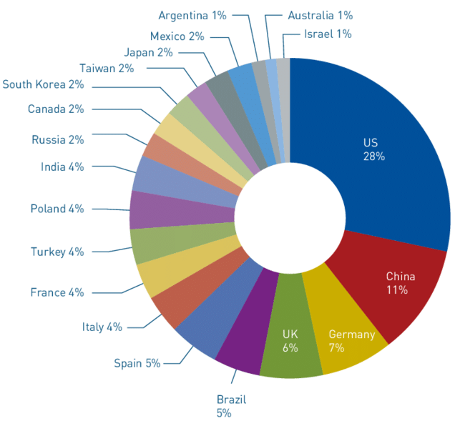
Cybercrime and the Legal Landscape around the World
-

Slide 16
Why Do We Need Cyber laws: The Indian Context
- Cyber Security is an important issue for every country in the world. India has an increasing number of cyber security issues, and it is important that India be willing to take responsibility for it. Cyber-attacks cost the country Rs. 1.25L crore each year, according to the recent economic times report on global cyber-crime.
The dawn of cyber laws in India started with the boom in globalization and computerization in India. The number of cyber-crimes registered each year in India is shocking and it is only getting worse.
As per a survey, the number of cyber-attacks in India, from February 2020 to March 2020, went from 1.3 million to 3.3 million. In July 2020, India reported its highest number of attacks of 4.5 million.
We have seen instances of hacking and stealing information from different websites in India.

Slide 17
Why Do We Need Cyber laws: The Indian Context
- Recently we have seen that RBI blocked MasterCard for being non-compliant with the direction of storage of Payment system data.
The threats from the internet are almost endless, and a cyber-security policy is the most effective way to combat that.

Slide 18
The Indian IT Act
- The Information Technology Act, 2000 (also known as ITA-2000, or the IT Act) is an Act of the Indian Parliament (No 21 of 2000) notified on 17 October 2000. It is the primary law in India dealing with cybercrime and electronic commerce.
The bill was passed in the budget session of 2000 and signed by President K. R. Narayanan on 9 June 2000. The bill was finalized by a group of officials headed by then Minister of Information Technology Pramod Mahajan.
The original Act contained 94 sections, divided into 13 chapters and 4 schedules. The laws apply to the whole of India. If a crime involves a computer or network located in India, persons of other nationalities can also be indicted under the law.
The Act provides a legal framework for electronic governance by giving recognition to electronic records and digital signatures. It also defines cybercrimes and prescribes penalties for them. The Act directed the formation of a Controller of Certifying Authorities to regulate the issuance of digital signatures.

Slide 19
The Indian IT Act
- The Act also amended various sections of the Indian Penal Code, 1860, the Indian Evidence Act, 1872, the Banker's Book Evidence Act, 1891, and the Reserve Bank of India Act, 1934 to make them compliant with new technologies.

Slide 20
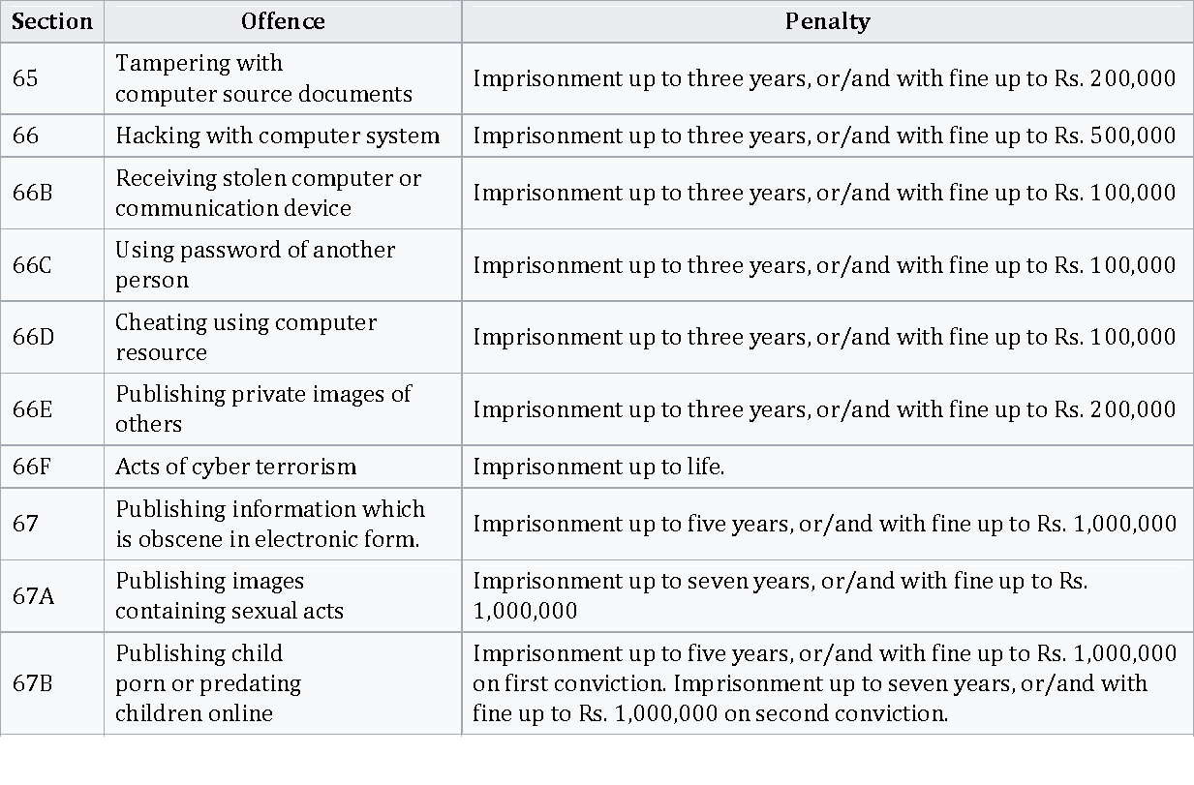
The Indian IT Act
-

Slide 21
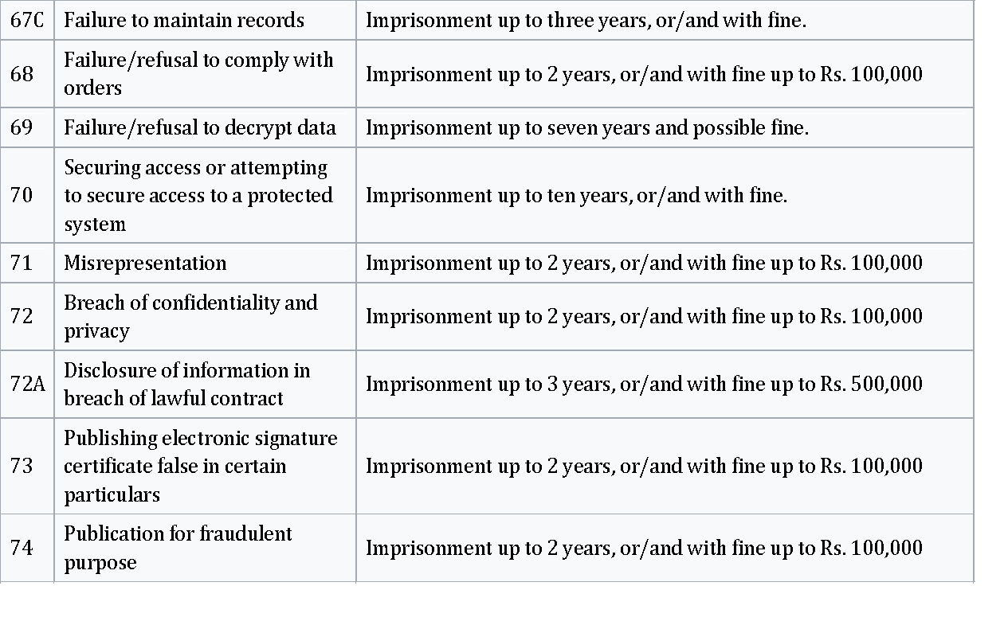
The Indian IT Act
-

Slide 22
The Indian IT Act
Notable cases:
1. Section 66:
In February 2001, in one of the first cases, the Delhi police arrested two men running a web-hosting company. The company had shut down a website over non-payment of dues. The owner of the site had claimed that he had already paid and complained to the police. The Delhi police had charged the men for hacking under Section 66 of the IT Act and breach of trust under Section 408 of the Indian Penal Code. The two men had to spend 6 days in Tihar jail waiting for bail.
2. Section 66A:
In September 2012, a freelance cartoonist Aseem Trivedi was arrested under the Section 66A of the IT Act, Section 2 of Prevention of Insults to National Honour Act, 1971 and for sedition under the Section 124 of the Indian Penal Code. His cartoons depicting widespread corruption in India were considered offensive.

Slide 23
The Indian IT Act
- On 12 April 2012, a Chemistry professor from Jadavpur University, Ambikesh Mahapatra, was arrested for sharing a cartoon of West Bengal Chief Minister Mamata Banerjee and then Railway Minister Mukul Roy. The email was sent from the email address of a housing society. Subrata Sengupta, the secretary of the housing society, was also arrested. They were charged under Section 66A and B of the IT Act, for defamation under Sections 500, for obscene gesture to a woman under Section 509, and abetting a crime under Section 114 of the Indian Penal Code.
- On 30 October 2012, a Puducherry businessman Ravi Srinivasan was arrested under Section 66A. He had sent tweet accusing Karti Chidambaram, son of then Finance Minister P. Chidambaram, of corruption. Karti Chidambaram had complained to the police.
- On 19 November 2012, a 21-year-old girl was arrested from Palghar for posting a message on Facebook criticizing the shutdown in Mumbai for the funeral of Bal Thackeray. Another 20-year-old girl was arrested for "liking" the post. They were initially charged under Section 295A of the Indian Penal Code (hurting religious sentiments) and Section 66A of the IT Act.

Slide 24
The Indian IT Act
On 18 March 2015, a teenaged boy was arrested from Bareilly, Uttar Pradesh, for making a post on Facebook insulting politician Azam Khan. The post allegedly contained hate speech against a community and was falsely attributed to Azam Khan by the boy. He was charged under Section 66A of the IT Act, and Sections 153A (promoting enmity between different religions), 504 (intentional insult with intent to provoke breach of peace) and 505 (public mischief) of Indian Penal Code.
3. Section 69A:
On 29 June 2020, the Indian Government banned 59 Chinese mobile apps, most notably TikTok, supported by Section 69A and citing national security interests.
On 24 November 2020, another 43 Chinese mobile apps were banned supported by the same reasoning, most notably AliExpress.

Slide 25
Amendments to the Indian IT Act
Amendments:
- A major amendment was made in 2008. The Amendment was created to address issues that the original bill failed to cover and to accommodate further development of IT and related security concerns since the original law was passed.
It introduced Section 66A which penalized sending "offensive messages". It also introduced Section 69, which gave authorities the power of "interception or monitoring or decryption of any information through any computer resource". Additionally, it introduced provisions addressing - pornography, child porn, cyber terrorism and voyeurism.
- The amendment was passed on 22 December 2008 without any debate in Lok Sabha. The next day it was passed by the Rajya Sabha. It was signed into law by President Pratibha Patil, on 5 February 2009.

Slide 26
Challenges to Indian Law and Cybercrime Scenario in India
Some of the Cybersecurity challenges in India are as follows:
1. Lack of uniformity in devices used for internet access:
With varying income groups in India, not everyone can afford expensive phones. In the US, Apple has over 44% market share. However, in India the iPhones with their higher security norms are used by less than 1% of mobile users.
The widening gap between the security offered by the high-end iPhone and lower cost mobiles make it almost impossible for legal and technical standards to be set for data protection by the regulators.
2. Lack of national level architecture for Cybersecurity:
Critical infrastructure is owned by private sector, and the armed forces have their own firefighting agencies. However there is no national security architecture that unifies the efforts of all these agencies to be able to assess the nature of any threat and tackle them effectively.

Slide 27
Challenges to Indian Law and Cybercrime Scenario in India
The Prime Minister’s Office has created a position towards this cause but there is a long way to go before India has the necessary structure in place.
3. Lack of separation:
Unlike countries or states, in cyberspace there are no boundaries, thus making the armed forces, digital assets of ONGC, banking functions, etc. vulnerable to cyber-attacks from anywhere. This could result in security breaches at a national level, causing loss of money, property or lives. To respond to possible threats on the country’s most precious resources, there is a need for a technically equipped multi-agency organization that can base its decisions on policy inputs and a sound strategy.
4. Lack of awareness:
As there is no National regulatory policy in place for cyber security there is a lack of awareness at both company level as well as individual level. Domestic netizens can protect and be protected from the cyber-attacks only if there is a guided and supervised legal framework.

Slide 28
Cybercrime and Punishment
1. Section 65. Tampering with computer source documents
Penalties: Imprisonment up to 3 years and / or
Fine: Two lakh rupees.
2. Section 66. Hacking with the computer system:
Penalties: Punishment: Imprisoned up to three years and
Fine: which may extend up to two lakh rupees. Or with both.
3. Section 67. Publishing of obscene information in electronic form:
Penalties: Punishment: (1) On first conviction --- imprisonment which may extend up to five years.
Fine: up to on first conviction which may extend to one lakh rupees.
4. Section 70. Protected System:
Penalties: Punishment: the imprisonment which may extend to ten years and fine.

Slide 29
Cybercrime and Punishment
5. Section 71. Penalty for misrepresentation:
Penalties: Punishment: imprisonment which may extend to two years
Fine: may extend to one lakh rupees or with both.
6. Section 72. Penalty for breach of confidentiality and privacy:
Penalties: Punishment: term which may extend to two years.
Fine: one lakh rupees or with both.
7. Section 73. Penalty for publishing Digital Signature Certificate false in certain particulars:
Penalties: Punishment imprisonment of a term of which may extend to two years.
Fine: fine may extend to 1 lakh rupees or with both.

Slide 30
Digital Signatures and the Indian IT Act
What is a Digital Signature?
A digital signature is a mathematical scheme for verifying the authenticity of digital messages or documents. A valid digital signature, where the prerequisites are satisfied, gives a recipient very strong reason to believe that the message was created by a known sender (authentication), and that the message was not altered in transit (integrity).
Digital signatures are a standard element of most cryptographic protocol suites, and are commonly used for software distribution, financial transactions, contract management software, and in other cases where it is important to detect forgery or tampering.
Digital signatures are often used to implement electronic signatures, which includes any electronic data that carries the intent of a signature, but not all electronic signatures use digital signatures. Electronic signatures have legal significance in our country

Slide 31
Digital Signatures and the Indian IT Act
In relation with IT Act:
- Digital signatures were given legal status in India, by Information Technology (IT ACT 2000) in the year 2000. It granted e-signatures on electronic documents, the same legal status as the handwritten signatures on physical documents.
- The IT Act 2000 applies to whole of India and it provides for enabling a person to use digital signature just like the traditional signature. The basic purpose of digital signature is same as a conventional signature, ie to authenticate the document, to identify the person and to make the contents of the document binding on person putting digital signature.
- Under Indian law, a written signature is not necessarily required for a valid contract - contracts are generally valid if legally competent parties reach an agreement, whether they agree verbally, electronically or in a physical paper document. The Information Technology Act, 2000 (IT Act) specifically confirms that contracts cannot be denied enforceability merely because they are concluded electronically.

Slide 32
Digital Signatures and the Indian IT Act
Though most electronic documents are allowed to be signed digitally, there are few exceptions that need to be executed using handwritten signatures. These documents are:
- A negotiable instrument as defined in section 13 of the Negotiable Instruments Act, 1881 (such as promissory note or bill of exchange);
- A power-of-attorney as defined in section 1A of the Powers-of-Attorney Act, 1882;
- A trust deed as defined in section 3 of the Indian Trusts Act, 1882;
- A will as defined in clause (h) of section 2 of the Indian Succession Act, 1925 including any other testamentary disposition by whatever name called;
- A contract for the sale or conveyance of immovable property or any interest in such property
“Digital signature” is defined under section 2(p) of IT Act 2000 as follows: "Digital Signature" means authentication of any electronic record by a subscriber by means of an electronic method or procedure in accordance with the provisions of section 3

Slide 33
Digital Signatures and the Indian IT Act
Section 3 explains the digital signature technology as:
- Subject to the provisions of this section any subscriber may authenticate an electronic record by affixing his digital signature.
- The authentication of the electronic record shall be effected by the use of asymmetric crypto system (use of private and public keys) and hash function which envelop and transform the initial electronic record into another electronic record
- The private key and the public key are unique to the subscriber and constitute a functioning key pair.
Digital signing is enabled using Digital Signature Certificates (DSC) that contains unique private and public key pair that serves as an identity of an individual / signer. As per the Act, DSC is issued by the authorities known as CA (Certifying Authorities) after following a prescribed procedure. Signing using digital signature certificates (DSC) issued by CA is considered legal.

Slide 34
Digital Signatures and the Indian IT Act
- There are three types of digital signatures based on security levels: Class-1, Class-2 and Class-3 certificates.
- Class 1 certificates do not carry legal recognition since its validation is done on the basis of a valid e-mail and is not based on direct verification.
- In case of Class-2 certificates the identity of the person is verified against a trusted pre-verified database.
- Class-3 is the highest level where a person is required to be present in front of a RA(Registration Authority) to prove his/her identity.
- Typically Class 2 certificate is required for signing most of the documents. DSC is typically issued on a USB token containing the digital-certificate-based digital ID, along with a personal PIN, to sign a document.
- Businesses in India have been using DSC based digital signatures to sign documents like invoices, form 16’s, PO’s, HR letters, reports, agreements and other documents.

Slide 35

Digital Signatures and the Indian IT Act
Other type of digital signatures recently allowed in India is the Aadhaar based signing. Aadhaar ID is a unique identification number issued by the Indian government to all Indian residents. In this method, signers can apply e-signatures to any online document by authenticating their identity using an eKYC service such as OTP (one time passcode) provided by an eSign Service Provider.

Slide 36
Cyber law, Technology and Students: Indian Scenario
- With newer technologies, we are getting exposed to bigger threats from hackers who are rapidly finding sophisticated ways to conduct cybercrimes. It won’t be wrong to say that such cyber-attacks are gaining ground in the education sector as more and more breaches in schools and higher education are widely reported.
It, therefore, becomes imperative to cover and protect the education sector with cybersecurity.
Educational institutes, which are trusted to safeguard students’ safety should have a robust cybersecurity infrastructure that cuts down all risks and leaves no scope for breaches. These institutions must understand that cybersecurity is not just crucial to protect against economical loss and avoid disruption but also vital to protect students from any kind of harm.
The education sector needs to secure its applications and systems and overcome any challenges that come in the way of cybersecurity.

Slide 37
Cyber law, Technology and Students: Indian Scenario
Educational institutions are an easy target for espionage as well since they are center points of research and hold prized intellectual property.
Thus, protection is a must which can be enhanced through training and authentication. Basic training for all users of a network to mitigate the risks of cyber-attacks can protect the network at all access points and reduce the chances of human error. Sharing tips with everyone on safe practices for cybersecurity is another way of going about it.
Additionally, user-friendly multi-factor authentication (MFA) tool could prove to be a highly economical yet safe way to safeguard against a cyber-attack. The process can prevent authorization access with an added layer of security while logging on to the network.
Education institutions across the world, including India, have been pushed to operate online from homes owing to the COVID-19 pandemic. As more teachers and students coordinate classes via the internet, they are constantly targeted by hackers through various forms of malware and cyber attacks.

Slide 38
Cyber law, Technology and Students: Indian Scenario
Spear-phishing attacks on Indian schools and colleges via Gmail have increased in September 2020 following a drop during the summer vacations (July-August). Over more than 1000 schools and colleges were targeted.
A report says, educational institutions are more than twice as vulnerable to phishing attacks than an average organization.
With the latest technology used by students, lack of awareness and understanding of cyber risks have led that they are highly exposed to the cyber attacks especially due to COVID 19 situation.
The students should be aware of these attacks and should take precautions while using various technologies on devices like computer, laptop, mobiles etc. since cyber attackers use cutting edge technologies and methods to exploit the students in India.

Slide 39
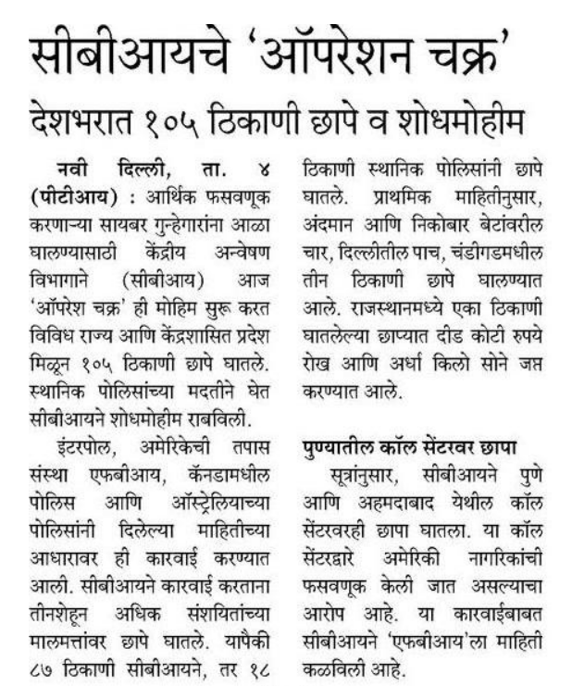
Latest News

Slide 40
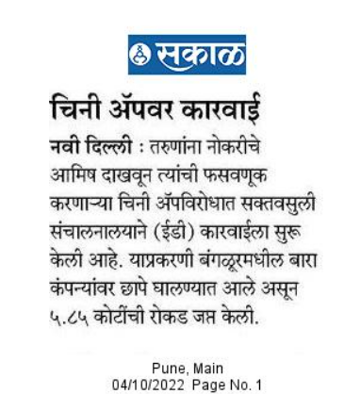
Latest News

Slide 41
Latest News
The Pimpri Chinchwad police have filed two cases against seven different internet users for uploading child pornography or child sexual exploitation content online.
The two cases were registered following ‘Tipline reports’ generated from an arrangement between the National Crime Records Bureau (NCRB) of India and the National Centre for Missing and Exploited Children (NCMEC), based in the US.
The NCMEC generates a ‘Tipline report’ after it gets a tip about content linked to child pornography or child sexual exploitation, verifies it and determines the possible location of the suspect. The report is made available to the concerned law enforcement agency of the country, which in India’s case, is the NCRB. The NCRB forwards this information to state police authorities.
It was based on seven such ‘Tipline reports’ that the Pimpri Chinchwad police registered two separate offences at Wakad and Chinchwad police stations on Wednesday. In the case registered at Wakad police station, two users who posted child pornography or child sexual exploitation content in May and June 2021 were booked. In the offence registered at Chinchwad police station, five users who posted such content between August 2020 and August 2021 were booked.

Slide 42
Latest News
In both cases, the police invoked the Information Technology Act, 2000 and Protection of Children from Sexual Offences Act, 2012. The police have also launched a probe into the cell phone numbers, email addresses and social media accounts used by the offenders to upload the content. In most of these cases, the content was uploaded on social media websites.
Since 2019, thousands of ‘Tipline reports’ have been generated about child pornography or child sexual exploitation content being posted online from India. Once individual police stations get the reports, they are registered as FIRs and are investigated. Maharashtra Cyber, the cyber crime and cyber security wing of the state police, is the nodal agency for such cases in the state.

Slide 43
Latest News
CBI Launches Operation Meghchakra, The Biggest Crackdown On Child Porn, Raid In 20 States
The Central Bureau of Investigation (CBI) has launched a massive nationwide crackdown on child pornography, with raids at 56 locations across 20 states on Saturday.
According to reports, the operation has been code-named Operation Meghchakra and is the biggest crackdown on child pornography by the agency to date.
Some 200 CBI officials have been involved in the crackdown, based on inputs from Interpol's Singapore-based Crime Against Child Unit against peddlers of Child Sexual Abuse Material (CSAM) are using cloud storage to circulate them online.
The ongoing operation was a follow-up of raids that were conducted in November 2021 in connection with the same crime, when it was named 'Operation Carbon'.

Slide 44
Latest News
"We have learnt that Cloud storage is being used by the accused in distribution of child sexual abuse material. We got inputs and developed it on our own. We located their hideouts based on technical surveillance and are now raiding them," a CBI source told.
In India publishing, transmitting or possession of materials in any electronic form which depicts children engaged in sexually explicit acts is a punishable offence.

Slide 45
Latest News
Razorpay – Lost ₹7.3 Crores
Online payment gateway Razorpay said hackers stole ₹7.3 crore worth of funds in 831 transactions over a period of 3 months.
According to media reports, “an unauthorized actor(s) with malicious intent” manipulated the authorization process of the gateway to authenticate these transactions.
Amazon, Flipkart, Airtel & JioMart – 10 Crore Data Sold
As per media reports, due to the cyberattack on Juspay in 2021, data of over 100 million client customers including those of Amazon, Flipkart, Airtel, and Jiomart was leaked and sold on the dark web for bitcoins worth $6,000.

Slide 46
Latest News
Oil India Ltd. – Ransom of ₹58 Crore
Between October 2021 and April 2022, the government-owned oil & gas extraction company Oil India Ltd. reported cases of cyberattacks.
It also found a ransom note on one of the infected computers, demanding $7,500,000
Tech Mahindra – Loss of ₹35 Crore In Smart City
In March 2021, Indian IT company Tech Mahindra which manages the Smart city project for Pimpri Chinchwad municipal corporation filed a criminal report about a ransomware attack that resulted in a loss of an estimated 35 crore.
Domino’s – 18 Crore Orders Gone Public
In May 2021, data related to 18 crore orders of Domino’s was made public on the internet. Anyone could see who & how many customers ordered their pizza, on the internet.

Slide 47
Latest News
Mobikwik – 10 Crore Users Data on Sale
Reportedly the data of nearly 10 crore users for mobile wallet & payments app MobiKwik was on sale on a hacker forum on the dark web in early 2021.
The data is said to have included KYC details for many of the users, and information such as Aadhaar card, signatures, etc.
Air India – 45 Lac Passengers Data Hacked
A sophisticated hacking attack on Air India’s passenger service system provider SITA resulted in the theft of personal data of around 4.5 million passengers in February 2021.
Frequent flyer data and credit card data were affected due to the breach.

Slide 48
Latest News
India witnessed 18 million cyber-attacks and 200,000 threats a day in the first quarter of 2022, said Google's VP-Engineering for Privacy, Safety and Security.

Slide 49


